Slide 1
Ecosystem
3SECU

Slide 2
3SECU –Ecosystem
Course Objectives
By the end of the course, students should:
Understand the global state of security
Know their position regarding security
Have a better knowledge of the world and impacts
Time:
course: 3h
exercises: 1h

Slide 3
Summary
Security Operation Center
SIEM

Slide 4
1. Security ecosystem

Slide 5
1. SOC
As you can expect, security is not done by magic in a company, there
are a lot of processes and multiple wheels in the ecosystem.
Companies and people are not just saying they are doing security,
they have to work with different teams, business unit to reach an
acceptable level of security for the company.

Slide 6
1. SOC
One key component of such systems is the SOC or Security
Operations Center.
This represents the team (or teams) working in a company and which
the job is to work on the security related to information systems.
The job is crucial and central (we could even say transversal) as this is
the team that centralize and monitor all access to both Cloud by also
local.

Slide 7
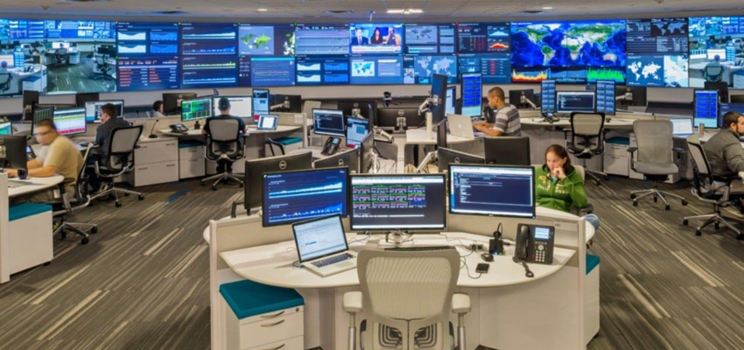
1. SOC

Slide 8
1. SOC
The SOC works on all systems part of the companies, from servers
and cloud, to networks and databases, with also all applications,
website and APIs.
They are working on finding all kinds of suspicious signals or
activities that are not "normal" and inspect if this is an expected
behavior or trace of some external people trying to gain access to
some system.

Slide 9
1. SOC
Teams in a SOC can be composed of multiple people with different
roles. From some specific manager to security engineer, but also
analyst.
In some special case, a SOC can also have some people focus in a
niche area with a strong skillset, for example cryptanalyst, reverse
engineering ...

Slide 10
1. SOC
These kinds of experts are normally not found in a SOC in companies,
but mostly linked to security companies that provide solutions for
other companies, or for military / state security.
Because yes, SOC is not just a way to "defend your company" the
same principle is used globally by most/all the countries around the
world.
Security is becoming critical everywhere !

Slide 11
1. SOC
From defending specific infrastructure like hospital or nuclear power
plan in time of peace, to gain access to specific knowledge by spying
on the smartphone of president and minister.
Or in time of war, by trying to block the communication network of
your enemies, trying to access military knowledge ...
And it is not always "advanced security". For example in Ukraine,
using some Ring camera (camera near your door to see who rings) to
know what's happening in a street

Slide 12
1. SOC
The main purposes of a Security Operations Center (SOC) are to:
Monitor and Analyze Activity: SOCs continuously monitor and analyze the activity on networks, servers, endpoints, databases, applications, websites, and other systems, looking for anomalous activity that could be indicative of a security incident or compromise.
Detect and Respond to Threats: One of the primary functions of a SOC is to quickly detect and respond to potential security threats. This includes identifying, analyzing, and prioritizing potential threats and coordinating a response to mitigate the risks.

Slide 13
1. SOC
Prevent Security Breaches: SOCs proactively work to prevent security breaches and intrusions. This involves deploying a range of preventive measures, such as firewalls, intrusion prevention systems (IPS), and malware protection.
Ensure Compliance with Regulations: SOCs help organizations comply with various industry and government regulations related to data security and privacy. This involves implementing and enforcing policies and procedures that are in line with compliance requirements.

Slide 14
1. SOC
Incident Response and Management: When a security incident is detected, the SOC is responsible for managing the incident response process. This includes coordinating with various stakeholders, containing the threat, eradicating the threat, recovering from the incident, and conducting a post-mortem analysis.
Perform Security Reporting and Communication: SOCs are responsible for reporting on security performance and incidents to stakeholders, including management and sometimes external parties. This reporting helps in strategic decision-making and keeps all relevant parties informed about the security posture.

Slide 15
1. SOC
Continuously Improve Security Posture: SOCs continually assess and improve an organization's security posture. This involves not only responding to current threats but also predicting and preparing for future threats. They do this by staying updated with the latest security trends, technologies, and threat intelligence.
Conduct Security Awareness and Training: SOCs often play a role in educating and training other employees within the organization about cybersecurity best practices, new threats, and safe computing habits.

Slide 16
1. SOC
Manage Security Tools and Technologies: SOCs are responsible for the management and maintenance of various security tools and technologies. This includes configuring and tuning security systems, updating security policies, and ensuring that all security measures are functioning optimally.

Slide 17
1. SOC
By fulfilling these roles, SOCs form an integral part of an organization’s strategy to protect its digital assets, maintain the confidentiality, integrity, and availability of its data, and ensure continuous business operations.

Slide 18
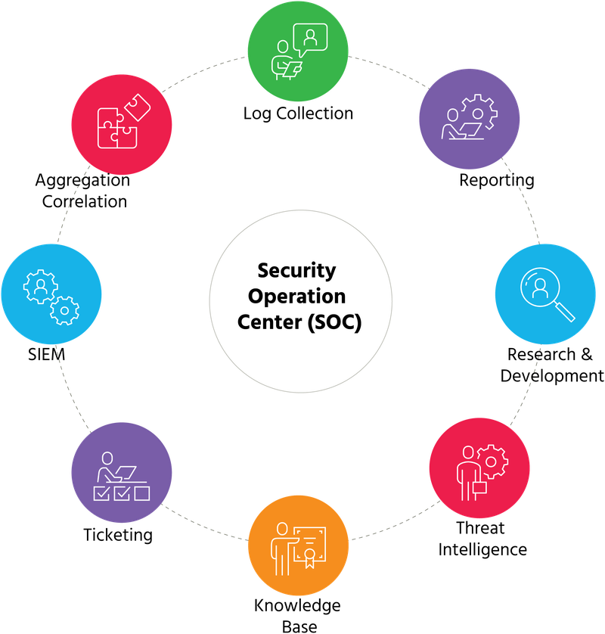
1. SOC

Slide 19
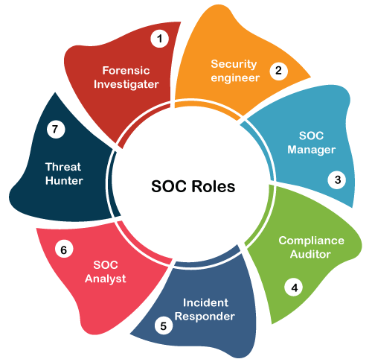
1. SOC

Slide 20

Exercises

Slide 21
2. SIEM

Slide 22
2. SIEM
The SOC also rely on some tools to help them analyze all the
networks and data. You can guess this is not a small amount of data,
we are talking about all the interaction between the system internally
but also with the public world !
For that, they use what we call SIEM - Security Information Event
Management.

Slide 23
2. SIEM
SIEM is a set of tools allowing teams to have one dedicated platform
to have a supervision tool and administration tool for everything.
This use tools to collect all the data (logs...) and do correlation
between them, allow some remote operation but also provide a full
monitoring solution including observability and alerting.

Slide 24
2. SIEM
SIEM stands for Security Information and Event Management. It is a comprehensive solution that combines two key functions: Security Information Management (SIM) and Security Event Management (SEM). Let's break down each component

Slide 25
2. SIEM
Security Information Management (SIM):
SIM involves the collection, storage, and analysis of data, primarily log files and other security-related documentation. It's focused on long-term data storage, management, and reporting.
SIM solutions are designed for compliance reporting and data retention, providing historical analysis and review of security data. This includes generating reports on security incidents and events over time, which can aid in audits and compliance reviews.

Slide 26
2. SIEM
Security Event Management (SEM):
SEM, on the other hand, is centered around real-time monitoring, correlation of events, notifications, and console views. It focuses on the current data and real-time analysis of security events.
SEM systems are designed to provide immediate and actionable information. They help in identifying and responding to active security threats as they occur, providing alerts based on a set of predefined conditions or rules.

Slide 27
2. SIEM
In essence, SIEM systems serve as a central point for collecting, analyzing, and reporting on security data, helping organizations to enhance their security posture, ensure compliance with regulations, and swiftly respond to emerging threats.
A SIEM system effectively combines the functionalities of both SIM and SEM. It collects and analyzes log and event data from various sources, providing real-time analysis to detect active threats and also maintaining historical data for compliance, trend analysis, and forensic purposes.

Slide 28
2. SIEM
SIEM tools aggregate data from multiple sources, such as network devices, servers, domain controllers, and more. They then use sophisticated techniques like data correlation, pattern recognition, anomaly detection, and alerting to identify and respond to security incidents.
The goal of SIEM is to provide a comprehensive and holistic view of an organization's information security, enabling IT teams to detect, understand, and respond to security incidents more effectively.

Slide 29
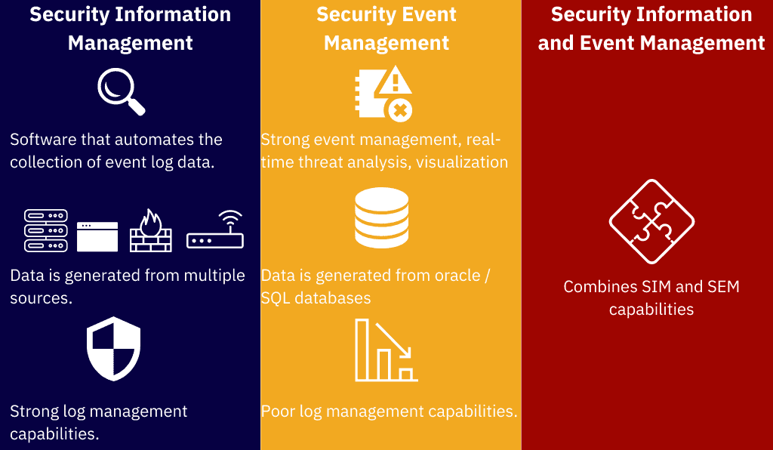
2. SIEM

Slide 30
2. SIEM
Security information and event management solutions operate by collecting logs from data sources within an organisation on a centralised platform. These data sources include Firewall, Antivirus, databases, servers and custom applications.
SIEM solution sorts the security data so that security teams can perform security analysis and identify any malicious activity such as brute force login attempts or different malware activities. Analysts can use pre-defined rules or create their own rules on this information and generate alerts with appropriate priority.

Slide 31
2. SIEM
SIEM solution is of paramount importance because it makes security analysis of massive amounts of logs collected by network and security devices a lot easier.
SIEM not only filters out unnecessary log data and noise but also allows security analysts to prioritise certain events by creating alerting notifications.

Slide 32
2. SIEM
Without a security information and event management solution, most suspicious activity within the infrastructure of an organisation may go unnoticed by security analysts.
SIEM solutions also help organisations in meeting the compliance requirements as SIEM solutions generate reports with all security events and logs.
Without a SIEM solution, this process would have been done manually.

Slide 33
2. SIEM
Rapid incident response is a must-have requirement for any security sensitive organisation.
Security analysts need relevant data to respond to a security incident. SIEM not only provides that information but also provides SIEM tools to automate the response to those incidents.

Slide 34
2. SIEM
The industry standards identify security information and event management solution to have three critical features given below:
Threat Detection
Threat Investigation
Incident Response

Slide 35
2. SIEM
Other important features offered by commercial SIEM solutions out there are:
Security Monitoring
Forensics of occurred incidents and response.
Log Ingestion
Log Parsing and normalisation
Security Incident Detection Engineering
Incident Response Workflow

Slide 36
2. SIEM
Security information and event management solutions have a lot of benefits for any security-conscious organisation that has hired skilled security professionals for threat detection and incident response.
Allows Security teams to rapidly identify network threats and reduce the impact of a cyber-attack.
Provides security analysts with a centralised view of the security activity of the whole organisation’s infrastructure. All the endpoints and network nodes sent log data to the SIEM solution for storage and processing.

Slide 37
2. SIEM
While SIEM (Security Information and Event Management) systems are powerful tools for enhancing an organization's cybersecurity posture, they do have certain limitations.
Understanding these limitations is crucial for effectively utilizing SIEM systems and for considering complementary security measures.

Slide 38
2. SIEM
Complexity and Resource Intensity: SIEM systems can be complex to configure and manage. They require significant resources in terms of hardware and skilled personnel to operate effectively. Smaller organizations might find it challenging to allocate the necessary resources.
False Positives and Alert Fatigue: One of the common challenges with SIEM systems is the high volume of alerts, many of which can be false positives. This can lead to alert fatigue among security analysts, potentially causing them to miss genuine threats.

Slide 39
2. SIEM
Dependence on Quality of Input Data: SIEM effectiveness is highly dependent on the quality of the input data. If the log data is incomplete, inaccurate, or not properly synchronized, it can lead to incorrect analysis and missed security incidents.
Need for Regular Updates and Tuning: SIEM systems require continuous tuning and updating of rules and algorithms to stay effective against evolving threats. This ongoing maintenance requires dedicated time and expertise.

Slide 40
2. SIEM
Scalability Challenges: As the volume of data and the number of sources increase, scaling a SIEM system can become challenging and expensive, both in terms of hardware and licensing costs.
Integration with Existing Systems: Integrating a SIEM system with existing security tools and infrastructure can be complex and may require additional configuration and customization.

Slide 41
2. SIEM
Skilled Personnel Requirement: SIEM systems require trained and experienced security analysts to interpret the data and respond to threats effectively. The shortage of skilled cybersecurity professionals can be a significant limitation for many organizations.
Cost: Implementing and maintaining a SIEM system can be costly, considering the expenses for software licenses, hardware, and skilled personnel.

Slide 42
2. SIEM
Despite these limitations, SIEM remains a vital component of an organization's security strategy.
It's important to complement SIEM with other security measures and practices, such as endpoint protection, employee training, and regular security audits, to build a comprehensive cybersecurity posture.

Slide 43
2. SIEM
Implementing a SIEM (Security Information and Event Management) system effectively requires adherence to a set of best practices.
These practices ensure that the SIEM tool not only functions efficiently but also aligns with the organization's security objectives.
Clear Definition of Objectives: Start by clearly defining what you want to achieve with your SIEM system. This includes identifying specific security threats, compliance requirements, and operational objectives.

Slide 44
2. SIEM
Proper Configuration and Customization: Customize the SIEM tool to suit your organization’s specific environment. This involves tuning correlation rules, alerts, and dashboards to reflect your network architecture, business processes, and security policies.
Comprehensive Data Collection: Ensure that the SIEM system collects data from all relevant sources. This includes logs from network devices, servers, applications, databases, and any other critical systems.

Slide 45
2. SIEM
Effective Log Management: Properly manage log data for accuracy and completeness. Ensure that time synchronization is maintained across all systems for accurate event correlation.
Regularly Update and Maintain the SIEM: Keep the SIEM software updated with the latest features and security patches. Regularly review and update rules, alerts, and response procedures to adapt to evolving threats.

Slide 46
2. SIEM
Prioritize and Correlate Alerts: Use correlation rules to filter out false positives and prioritize alerts based on their potential impact on the organization. This helps in focusing on the most critical threats.
Incident Response Integration: Integrate your SIEM system with your incident response plan. Ensure that alerts trigger appropriate response actions and procedures.

Slide 47
2. SIEM
Staff Training and Expertise: Ensure that your team has the necessary training and expertise to manage and operate the SIEM system effectively. Consider investing in specialized training or certification programs.
Compliance and Regulatory Requirements: Align your SIEM operations with compliance and regulatory requirements pertinent to your industry. Regularly review compliance reports and audit trails.

Slide 48
2. SIEM
Regular Reviews and Audits: Conduct regular reviews and audits of the SIEM system to evaluate its effectiveness and make necessary adjustments.
Threat Intelligence Integration: Integrate external threat intelligence feeds into your SIEM system to enhance its ability to identify known threats and adapt to emerging risks.
Scalability and Performance: Ensure that the SIEM system is scalable to handle increased data volumes and is performing optimally to meet the needs of your growing organization.

Slide 49
2. SIEM
In the following slides you will see some screenshot based on multiple dashboards using Datadog as a Security Center.
You will find some interface allowing you to see
what is your compliance following all the standards (technical or regulatory)
a complete list of all resources that are being scanned, showing the result as misconfiguration, security threat or all other feedback

Slide 50
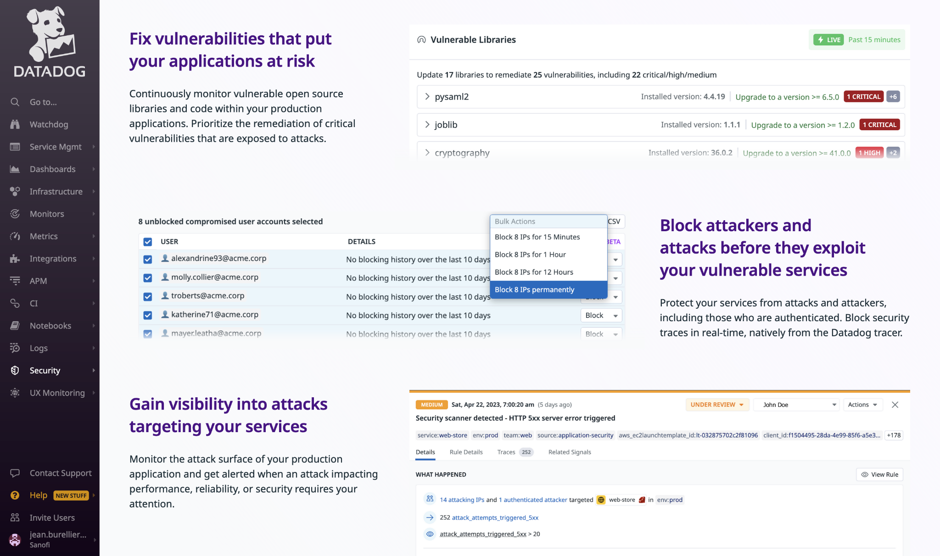
2. SIEM

Slide 51
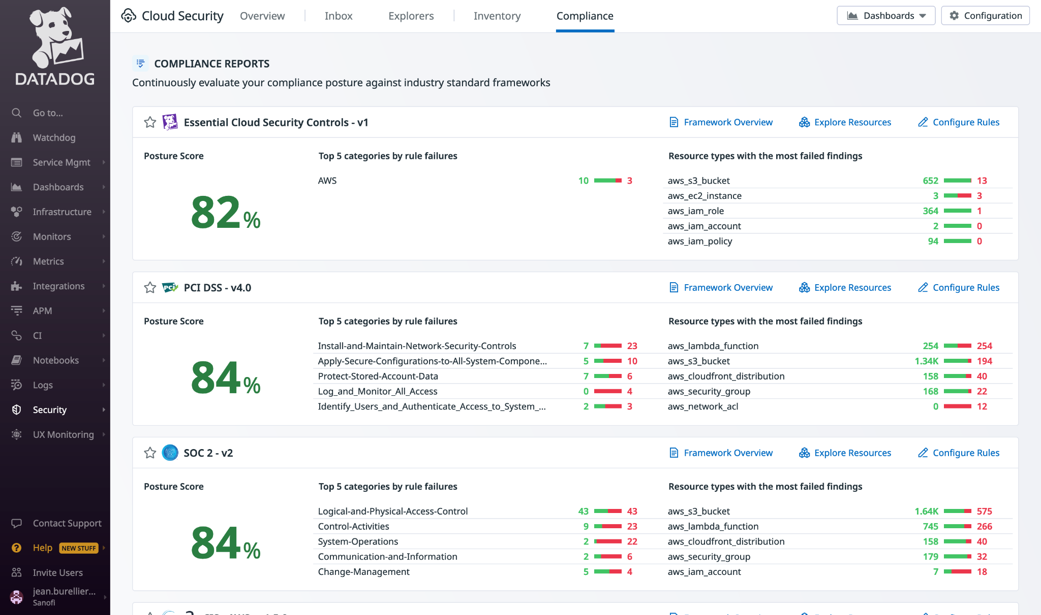
2. SIEM

Slide 52
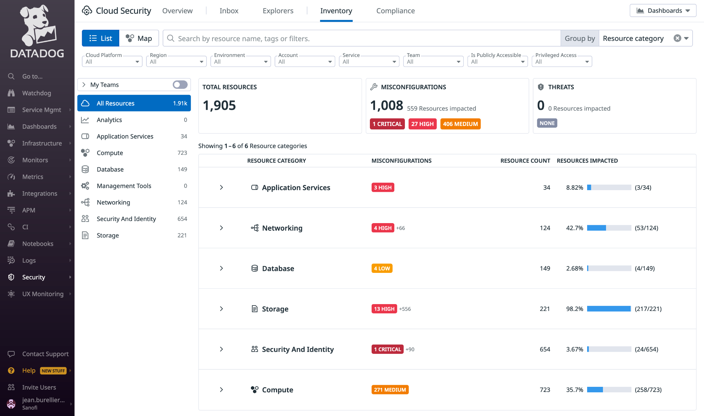
2. SIEM

Slide 53
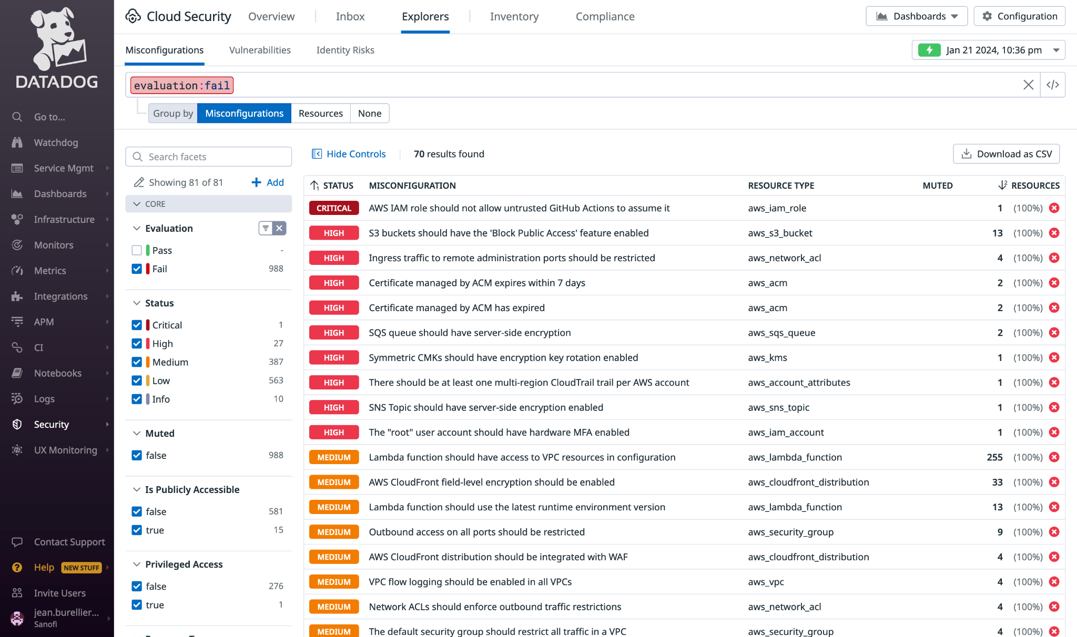
2. SIEM

Slide 54
Exercises

